Slide 1
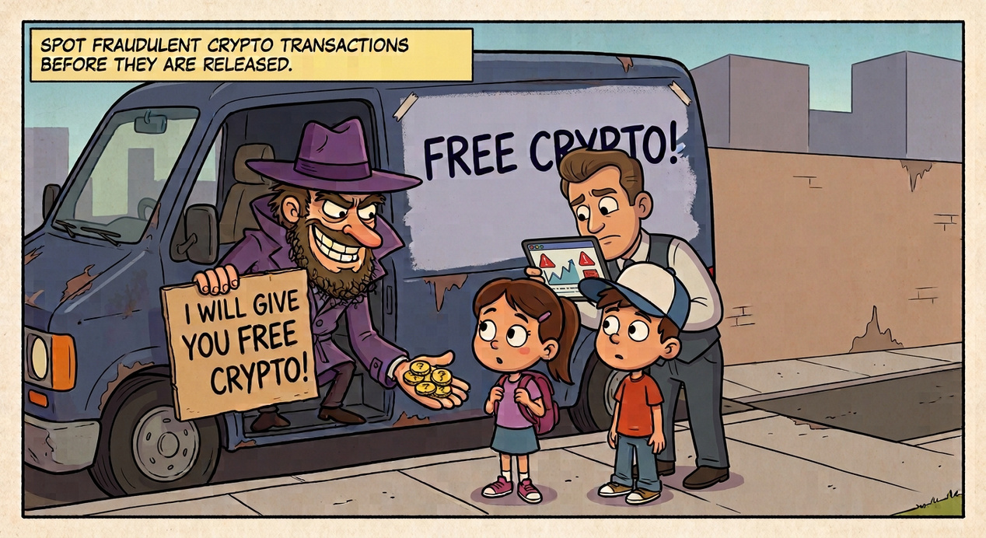
Crypto Fraud
Spotting fraudulent crypto transactions before they are released
Notes:
Whoever opens (about 10 seconds): “Hi, we are the dream team. Our client is a crypto exchange that wants to catch fraudulent transactions before the money leaves. We built a Streamlit app for that.” Then hand over to the next slide.
1

Slide 2
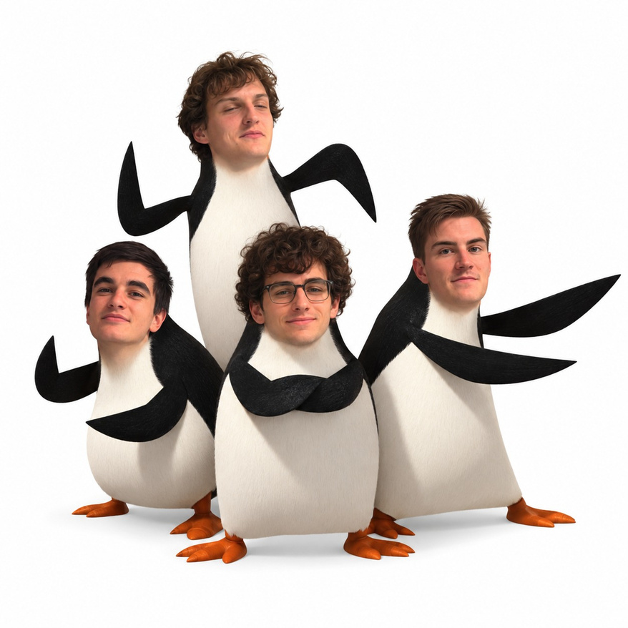
The Dream Team
Introducing the dream team
  Vadim() #he is a function
  Spyros
  Manos
  Luca
Notes:
Speaker: anyone, 10 seconds. “Introducing the dream team: Vadim, Spyros, Manos and Luca.” Each person can raise a hand when their name is said.
2

Slide 3
Purpose of the App
  Help the fraud analysts team decide if a flagged crypto transaction is fraud
  User: the fraud analysts team at a crypto exchange
1. Explore the data
Compare fraud and clean transactions per feature, with SQL
2. Predict
Enter a new transaction and get a verdict: fraud or clean
3. Explain
See the 3 most similar past transactions behind each verdict
Notes:
Speaker: [design person 1], about 45 seconds. “Our client is a crypto exchange. Their fraud analysts get flagged transactions and have to decide quickly if they are fraud, before the money leaves. Our app helps with three things: exploring the data to see how fraud differs from clean transactions, predicting whether a new transaction is fraud, and explaining that prediction by showing the three most similar past transactions.”
3

Slide 4
Requirements Agreed with the Client
User questions
The app must
1. Which transaction features differ between fraud and clean?
  Show statistics of a chosen feature for fraud and clean, with pandasql
  Show the fraud rate per verification level
  Let the user enter a new transaction
  Classify it as fraud or clean with the saved model
  Show the 3 most similar past transactions next to each verdict
2. Which account verification level has the most fraud?
3. Is this new transaction likely fraud, and which past transactions does it look like?
Machine learning goal: classification (fraud or clean)
Notes:
Speaker: [design person 1 or 2], about 45 seconds. “With our TA as the client we agreed on three user questions [read them] and on what the app must do: show statistics per feature for fraud and clean, show the fraud rate per verification level, let the user enter a transaction, classify it with our saved model, and show the three most similar past transactions next to every verdict. The machine learning goal is classification: fraud or clean.” CHECK: make the questions and the requirements match your Requirements Document (1.3.1) if they differ.
4

Slide 5
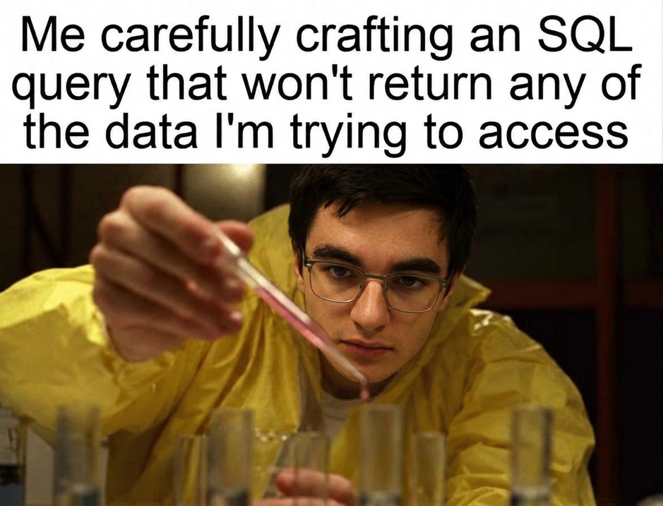
Data Cleaning
  400 transactions, 16 features, 175 fraud and 225 clean
What we checked | What we found | What we did
Column types | 15 number columns, 1 text column (kyc_tier) | One-hot encoded kyc_tier
Missing values | None | No imputation needed
Inconsistencies | None, after SQL checks on every column (negative amounts, hours outside 0–23, fractions outside 0–1, unknown KYC tiers) | Nothing to fix
Outliers | Many with the IQR rule (49 in amount, 103 in balance change) | Kept them: fraud is often unusual and the values are valid
Notes:
Speaker: Manos, about 1 minute. “Before training anything we checked the data. 400 transactions, 175 fraud and 225 clean. Fifteen columns are numbers and one is text, the verification level, which we one-hot encoded for the model. There were no missing values, so no imputation was needed. With SQL we checked every column for impossible values, like negative amounts, hours outside 0 to 23 or fractions above 1, and we found none. We did find outliers with the IQR rule, for example 49 in the amount, but we kept them, because fraud is often unusual and the values are real.”
5

Slide 6
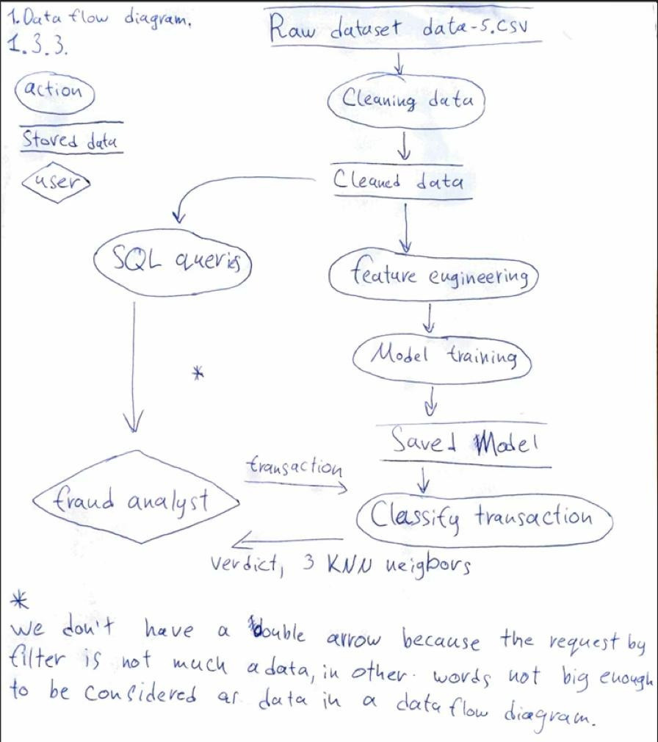
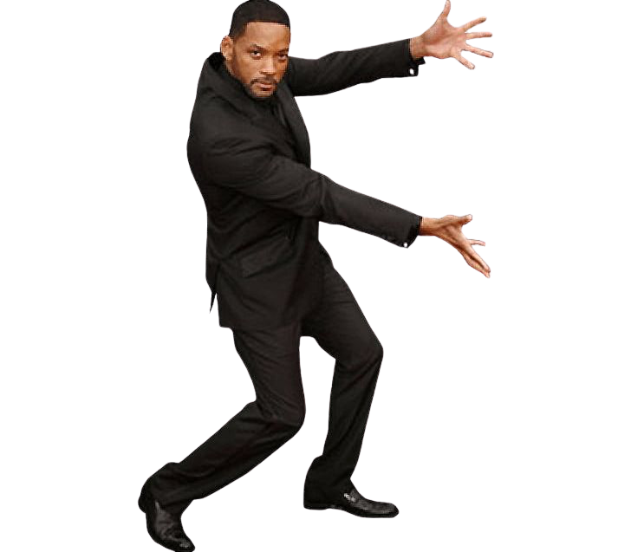
Data flow diagram
  Raw data: 400 flagged transactions
  Analyst makes the final decision
Notes:
Speaker: [design person 2], about 1 minute. “This is how data moves through our system. Training happens once, in our notebook: we read the CSV, check it with SQL, keep five features, one-hot encode and scale them, train KNN with k equals 3, and save the model and the scaler. The app then has two flows. On the Statistics page the user picks a feature and a pandasql query computes the statistics for fraud and clean. On the classification page the user enters a transaction, it is encoded and scaled with the saved scaler, the saved model gives a verdict, and we show the three most similar past transactions.” If you have your own drawn data flow diagram from the design document, you can put a picture of it here instead.
6

Slide 7
Machine Learning: KNN Classifier
  K-nearest neighbours, k = 3
  Features scaled, 80% train and 20% test
  5 features: amount, wallet age, time between transactions, spread of that time, KYC tier
How we chose the features
1. Compared the averages of fraud and clean
With SQL, for every column
Notes:
Speaker: [your friend’s name], about 1 minute. “At first we used SQL to compare the average of every column for fraud and clean transactions. The columns with a clear difference looked useful, so those were our candidates. Then we did backward elimination: we removed them one by one and checked the error. Balance change and the share of new addresses didn’t make the model better, so we dropped them, and we kept five features. The model is a KNN classifier with k equals 3. On 80 transactions it had never seen, it is right 70 percent of the time, against 56 percent if you always guess clean. It catches 24 of the 35 frauds, that’s the recall, and 24 of its 37 fraud alarms are correct, that’s the precision. In our notebook we reported this as an MAE of 0.30, which for fraud or clean is simply the share of wrong answers.”
7

Slide 8
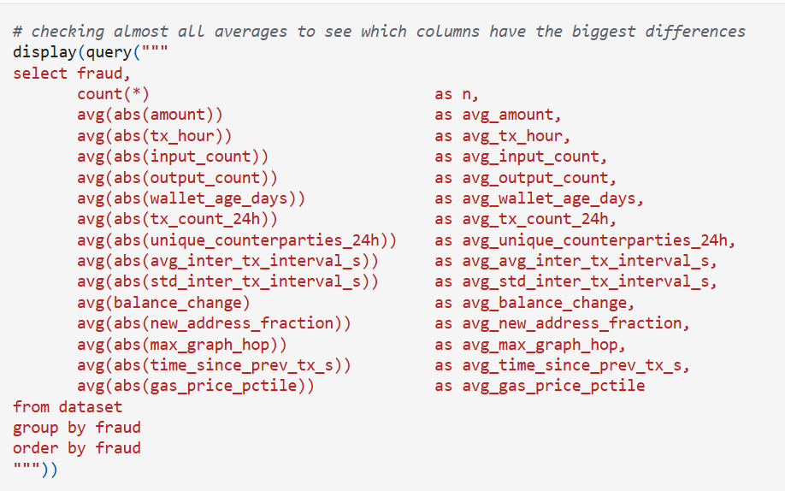

Slide 9
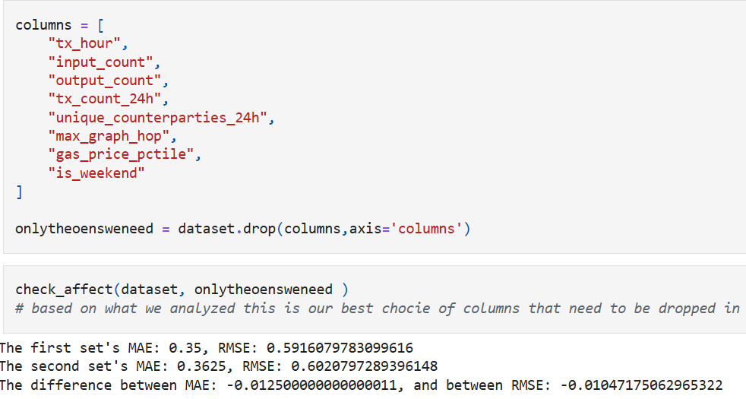

2. Kept the columns with a clear difference
These were our candidates

Slide 10

2. Kept the columns with a clear difference
These were our candidates

Slide 11

2. Kept the columns with a clear difference
These were our candidates

Slide 12


2. Kept the columns with a clear difference
These were our candidates

Slide 13

2. Kept the columns with a clear difference
These were our candidates
Us thinking what is the correct feature
selection

Slide 14
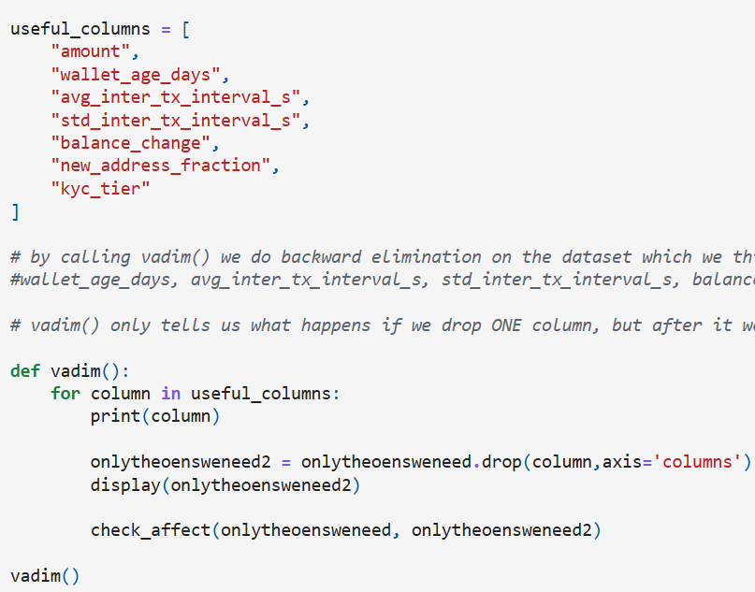
3. Backward elimination
Balance change and new address share didn’t help, so we dropped them

Slide 15
3. Backward elimination
Balance change and new address share didn’t help, so we dropped them

Slide 16
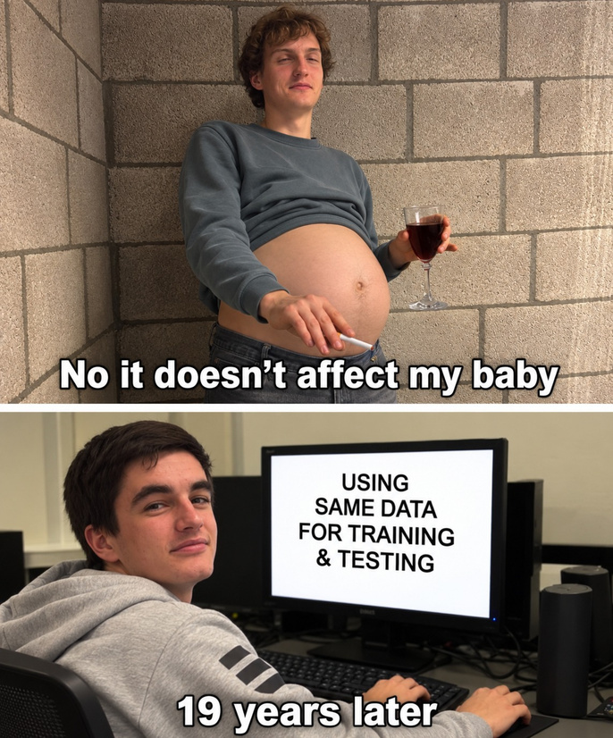
3. Backward elimination
Balance change and new address share didn’t help, so we dropped them

Slide 17


3. Backward elimination
Balance change and new address share didn’t help, so we dropped them
Without balance change :
Without new_address_fraction :

Slide 18

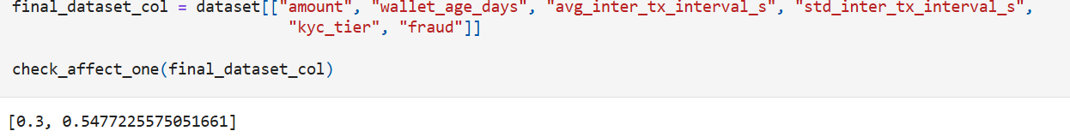
Results on 80 unseen transactions
Metric | Result
Accuracy | 70%
Recall | 69% (24 of 35 frauds caught)
Precision | 65% (24 of 37 alarms right)
MAE | 0.30 (share of wrong answers)
RMSE | 0.55

Slide 19
Live Demo
1. Statistics page
Pick a feature and compare fraud with clean transactions
2. Fraud classification page
Enter a transaction, get a verdict and its 3 most similar past transactions
Notes:
Speaker: [whoever built the pages], 2 to 3 minutes. Switch to the app (already running: streamlit run Statistics.py). 1. Statistics page: choose “amount”, point at the fraud mean vs the clean mean. Then choose “kyc_tier” and show the fraud rate table. 2. Fraud classification page, example that comes out FRAUD: amount 85.26, wallet age 58, seconds between transactions 536, standard deviation 1147, verification stage unverified. Submit, read the verdict, point at the 3 most similar past transactions. 3. Example that comes out NOT FRAUD: amount 196.97, wallet age 113, seconds between transactions 1060, standard deviation 931, verification stage full. Write these two examples on paper before the presentation.
8

Slide 20

Reflection...
Notes:
Speaker: anyone, about 45 seconds. “What worked well: we split into a design team and a data team and joined everything in one app, the SQL exploration showed us which features to try, and showing the three most similar transactions makes every verdict easy to check. What could be better: we picked features using a test set of only 80 transactions, so one transaction changes the score by more than one percent. The app also asks for inputs the model doesn’t use, and at first we measured MAE instead of accuracy. In the next iteration we would use cross-validation to choose the features and k, show how sure the model is, and only ask for the five inputs it needs. Thank you, any questions?”
9

Slide 21
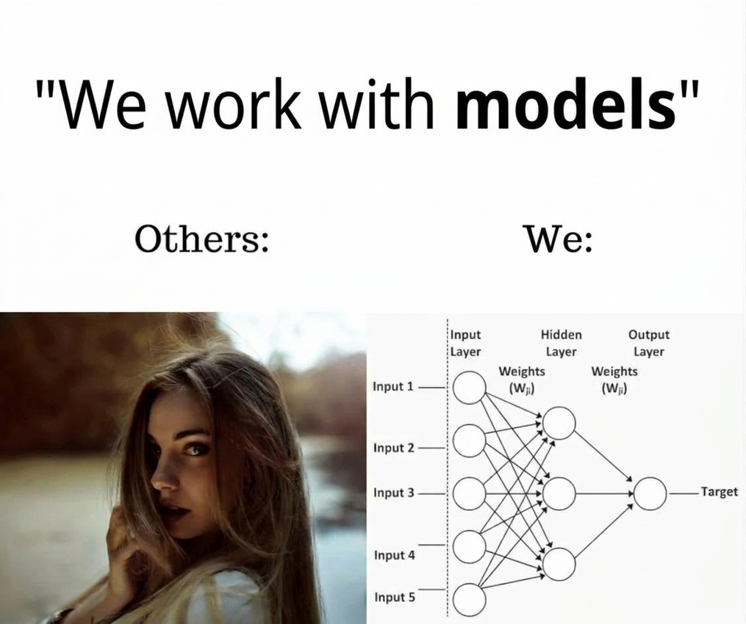
At the end of the day
We really liked working with models,
and we are very proud that we chose The Right thing
The Left thing: The Right thing:
both models, not the same thing though

